Slide 1


Dev Misra

Slide 2
Background
Decided to investigate the betting lines set on the total points scored for games
From this data, I would be able to predict the total points scored for each game played and leverage the model to predict whether the Over or Under on total points will happen
Some important factors that I’m interested in are:
Date of the game, Home Team, Away Team, Total Score, Total Score Open (Betting Line)
Weather Conditions: Average Temperature, Average Humidity, Average Wind Speed, and existence of Precipitation (type),
At a high level, and after some research, I specifically became interested in detailing how environmental factors affect the total points scored in a game

Slide 3
Data Set
Located scores and betting data of all NFL games starting from 2006 regular season to present
Grouped into columns representing Home Team, Away Team, Home Score, Away Score, Total Score, Total Score Open (which is the set Over/Under line), and Line Differential
The most important external factors effecting total score identified from preliminary analysis were the weather conditions for each game
To account for this, added weather data for all the NFL games from 2006 to 2016
Added columns showing Average Temperature, Average Humidity, Average Wind, Precipitation, and Fog/Haze to the applicable years within the data set

Slide 4
Preliminary Analysis
- Weather conditions that most influence the overall performance are temperature, humidity, wind speed, precipitation, and fog/haze
- If a game is played in a a closed dome stadium, all impacts of above weather conditions are rendered null, creating the optimal environment for teams to score more points
My preliminary analysis of historic over/under lines showed that taking the over is more appealing, yet when the over/under line is higher than the mean of all over/under bets, the under bet won with increasing frequency.

Slide 5
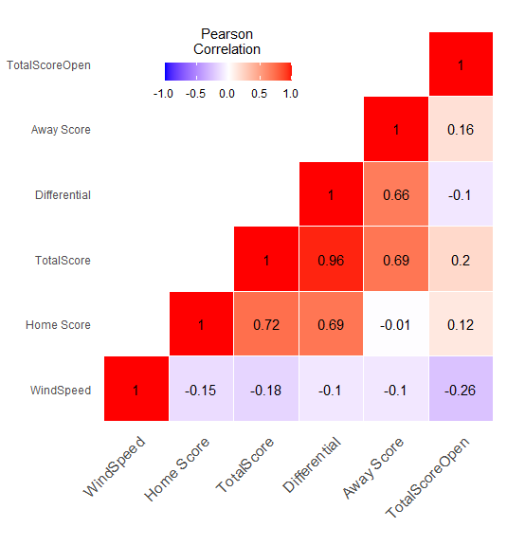
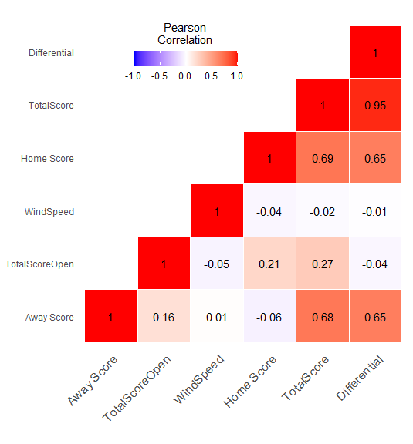
Heat Maps - Wind
Low/No Wind (Under 6 miles per hour - sample of 443 games):
High Wind (Over 13 miles per hour - sample of 268 games):
Notes:
Degree of correlation:
Perfect: If the value is near ± 1, then it said to be a perfect correlation: as one variable increases, the other variable tends to also increase (if positive) or decrease (if negative).
High degree: If the coefficient value lies between ± 0.50 and ± 1, then it is said to be a strong correlation.
Moderate degree: If the value lies between ± 0.30 and ± 0.49, then it is said to be a medium correlation.
Low degree: When the value lies below + .29, then it is said to be a small correlation.
No correlation: When the value is zero.

Slide 6
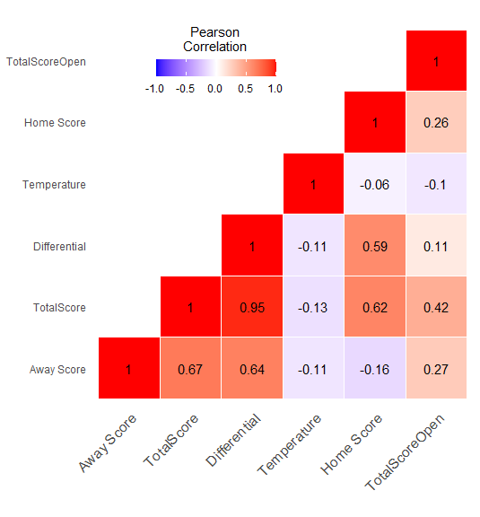
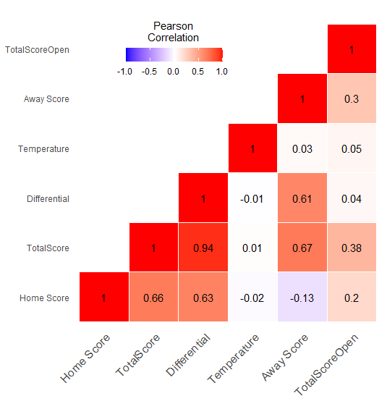
Heat Maps - Temperature
Very Hot Weather (Over 80°F - Sample of 153 games):
Very Cold Weather (Under 30°F - Sample of 89 Games):

Slide 7
Model Creation Processes
I began with a decomposition of the response variable (TotalScore), followed by the creation and analysis of a Holt-Winters model and an ARIMA model
Decided to use one team’s data (the Seattle Seahawks) in order to build my preliminary models
Split into a training set and test set for each model
Created a data frame containing Total Score, Average Wind Speed, Average Temperature, Average Humidity, and Precipitation
Compared values forecasted by training set to actual values from test set to determine model accuracy

Slide 8
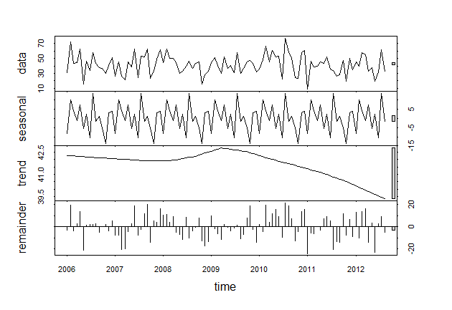
Decomposition of Total Score

Slide 9
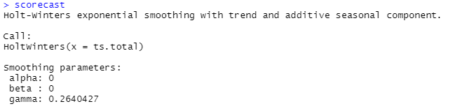
Holt-Winters Output
Based on the decomposition done in the previous slide, a pattern in the seasonality component can be observed
Running the Holt-Winters function indicates that there is seasonality (as shown by the gamma)
To account for seasonality in the model, the gamma parameter is set to .26

Slide 10
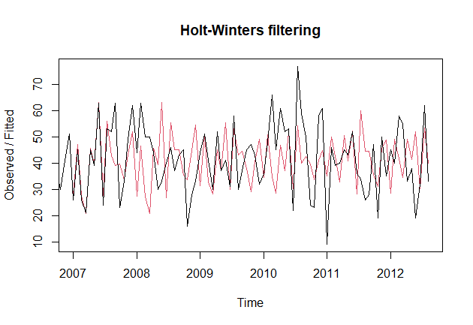
Holt-Winters Filtering on Total Score

Slide 11
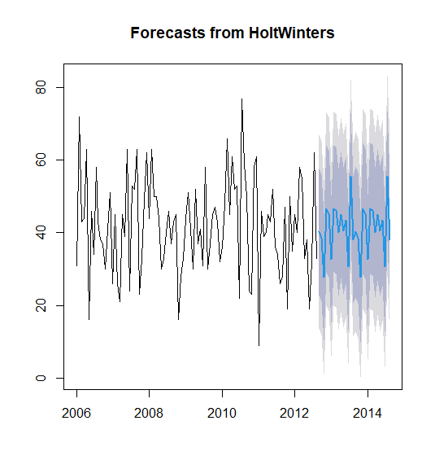
Holt-Winters Forecast and Accuracy
projectedScores <- scorecast2$mean
realLine <- data[101:130, 9]
projectedDifferential = projectedScores - realLine
realDifferential <- data[101:130, 11]
productDiff <- projectedDifferential * realDifferential
posProductDiff <- productDiff[which(productDiff >= 0)]
length(posProductDiff)/length(projectedScores)
= 12/30 = 0.4 = 40%

Slide 12
Box Test on Holt-Winters Forecast
> Box.test(scorecast2$residuals, lag = 20, type = "Ljung-Box")
Box-Ljung test
data: scorecast2$residuals
X-squared = 30.892, df = 20, p-value = 0.05664
According to the box test, the p-value is .05664, which is greater than .05
This indicates that the ACFs of the residuals are not equal to 0
However, it is very close to .05 so we will attempt to improve the forecast

Slide 13
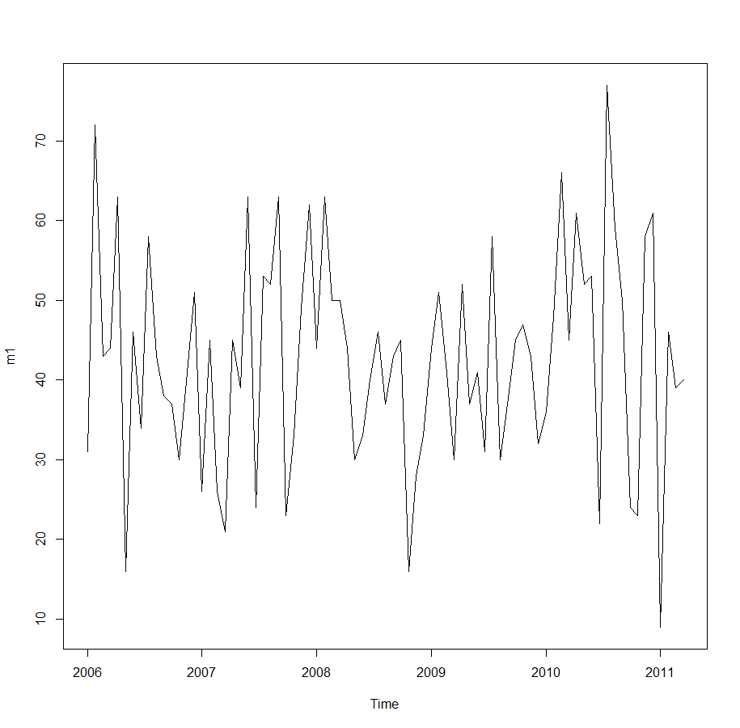
ARIMA Model
plot(m1)
t1 <- train[,7] #total score column
wind <- train[,9]
temp <- train[,10]
humidity <- train[,11]
t <- cbind(wind,temp,humidity)
m1 <- ts(t1, start = c(2006,38),
end = c(2011,41), frequency=15)
fitm2 <- auto.arima(m1, xreg = t)
f1 <- forecast(fitm2, xreg = t)

Slide 14
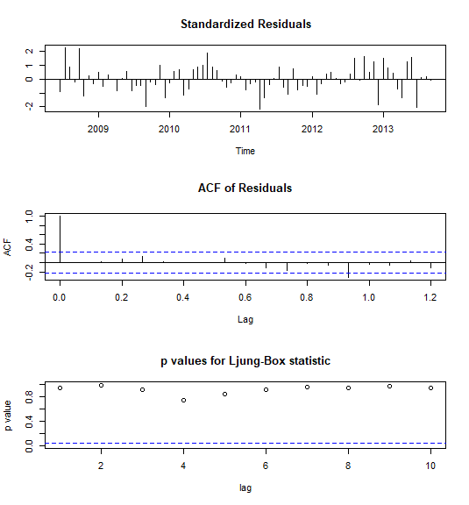
ARIMA Model Output (cont.)
> tsdiag(fitm2)
> fitm2
Series: m1
Regression with ARIMA(3,0,1) errors
Coefficients:
ar1 ar2 ar3 ma1 intercept
-0.8275 -0.1271 -0.1135 0.6140 72.2015
s.e. 0.2896 0.1604 0.1285 0.2751 10.9099
wind temp humidity
-0.9186 -0.2602 -0.1303
S.e 0.3307 0.1064 0.0952
sigma^2 estimated as 169.3: log likelihood=-310.68
AIC=639.36 AICc=641.97 BIC=660.69

Slide 15
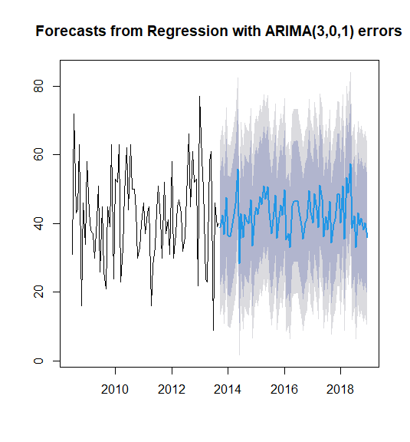
ARIMA Forecast
> plot(f1)
x =1 at location where predicted values begin
x | y | x | y
1 | 38.81489 | 11 | 28.41210
2 | 42.39381 | 12 | 42.89350
3 | 36.78633 | 13 | 35.98835
4 | 47.60939 | 14 | 42.60429
5 | 36.73060 | 15 | 40.70436
6 | 36.22181 | 16 | 39.99184
7 | 38.56453 | 17 | 46.85284
8 | 42.72520 | 18 | 33.40350
9 | 45.74917 | 19 | 42.48318
10 | 55.92364 | 20 | 44.65914

Slide 16
ARIMA Forecast Accuracy
Possible reasons for model inaccuracy:
Roster differences over the course of multiple seasons
Differing levels of opposing teams’ defenses, both over the course of a season and over multiple seasons
Possible improvements to address model inaccuracy:
Account for Average Points Scored by the Seahawks (for the season) and Average Points Allowed by opposing team (for the season)
projectedScores <- f1$mean
realLine <- data[80:158, 9]
projectedDifferential = projectedScores - realLine
realDifferential <- data[80:158, 11]
productDiff <- projectedDifferential * realDifferential
posProductDiff <- productDiff[which(productDiff >= 0)]
length(posProductDiff)/length(projectedScores)
= 45/79 = 0.5696203 = 56.96%

Slide 17
Questions

